Slide 1
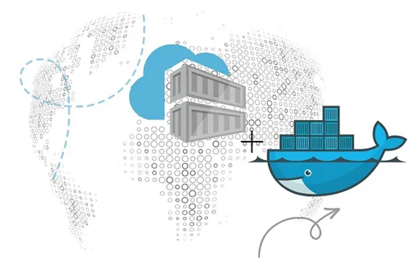
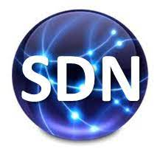
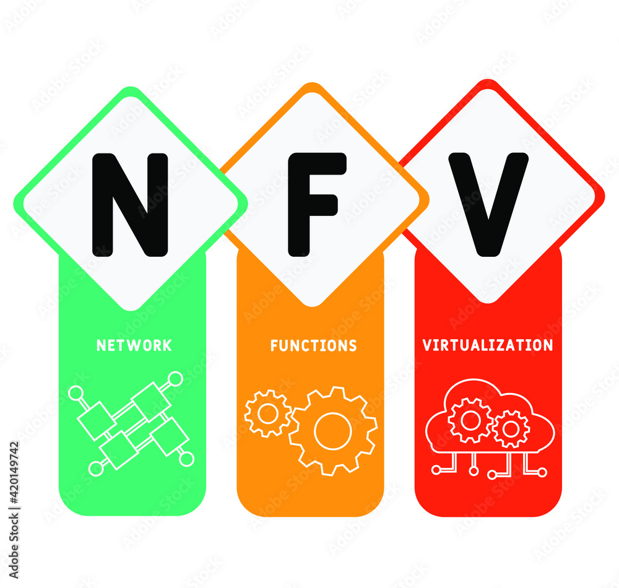
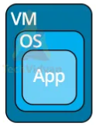
PDS
Computer Vision
Machine Learning Model with Docker and Kubernetes on Google Cloud Platform
.
https://github.com/siagianp
https://www.youtube.com/@AmelOline/videos
https://github.com/amelcharolinesgn2/IoT_simulator-mqtt-NodeRed
https://github.com/amelcharolinesgn2/Cloud-Infrastructures
Notes:
https://www.itwonderlab.com/kubernetes-with-terraform/

Slide 3
Deploying Deep Learning Models on Kubernetes with GPU

Slide 4
Kubernetes For AI Hyperparameter Search Experiments |

Slide 5
Github
Automate provisioning in the self-service platform
Notes:
https://conferences.oreilly.com/artificial-intelligence/ai-ny-2019/public/schedule/detail/72321.html
https://s.itho.me/events/2019/k8s/1525-1605%20%E5%BC%B5%E5%AE%B6%E6%A3%A0_AI%20on%20Kubernetes.pdf
https://medium.com/hackernoon/gpus-kubernetes-for-deep-learning-part-1-3-d8eebe0dd6fe
https://github.com/alibaba/GPU-scheduler-for-deep-learning

